Slide 1
Structural Text Segmentation of Legal Documents
Dennis Aumiller, Satya Almasian, Sebastian Lackner, Michael Gertz, 2021

Slide 2
Abstract
Increasing interest in legal information
Properly formatted document
Lack of context
Segments to topics
Transformer networks
74000 Terms-of-Service documents
Outperforming baselines

Slide 3
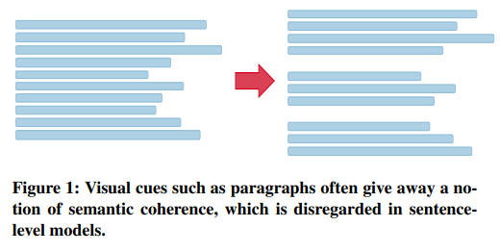
Introduction
Sequence of semantically coherent segments
User are satisfied by retrieving only the relevant subtopic
Many legal documents are single text elements
PDF or scans, no hierarchical information
Topic boundaries – more paragraphs
Previous works focus only on the sentences
Topic boundaries generally do not appear in the middle of a paragraph

Slide 4
Introduction
NLP – large body of existing work
Unsupervised, no large labeled datasets, heuristics
Topically related words appear in a segment or latent-topic vectors
With the availability of annotated data, text segmentation has also been formulated as a supervised learning problem
Most methods utilize a hierarchical neural model, where the lower-level network creates sentence representations, and a secondary network models the dependencies between the embedded sentences
Dependency between sentences is modeled in a hierarchical structure, these models fail to take advantage of larger pre-trained language representations, such as BERT and RoBERTa
Transformers, Terms-of-Service dataset containing annotated paragraphs
Topical coherence is a special case of binary classification of Same Topic Prediction, finetuning transformer
Model evaluation against the traditional embedding baselines and compare them to supervised and unsupervised approaches

Slide 5

Contribution
(𝑖) We present the task of structural text segmentation on coarser cohesive text units (paragraphs/sections).
(𝑖𝑖) We investigate the performance of transformer-based models for topical change detection.
(𝑖𝑖𝑖) frame the task as a collection of independent binary predictions, reducing overhead for hierarchical training and simplified training sample generation.
(𝑖𝑣) We present a new dataset consisting of online Terms-of-Service documents partitioned into hierarchical sections, and make the data available for future research.
(𝑣) We evaluate our model against classical baselines for text segmentation
(𝑣𝑖) show the effectiveness of our generated embeddings for structural segmentations to obtain superior performance to other text segmentation techniques.

Slide 6

Legal Document Understanding
Long history
Generally concerned with a specific information extraction, metadata of French law documents
HTML/XML structure
Clustering techniques na subtopics
Clustering for heterogeneous document collections, not focusing on the actual textual content
Metadata labels based on a CRF, element classification
European case-law decision, sentence embeddings

Slide 7
Topic analysis
Topic modeling approaches
LDA treats documents as bag-of-words
Markovian topic, dependencies between words
Rise of distributed word representation, LDA and word embedding
Primary segmentation, without predicting topics, focus on the segmentation methods

Slide 8
Text segmentation
The task of dividing a document into a multiparagraph discourse unit, topically coherent
1994, datasets are small and limit their scope to sentences
Choi dataset 920 synthesized passages from the Brown corpus
C99 probabilistic algorithm measuring similarity via term overlap
GraphSeg
TopicTiling (LDA), term frequency vector, PLSA, 218 Wiki dataset
Unsupervised learning approaches, small datasets, supervised and 43056
LSTM for learning sentence representation and dependencies, cleaned Wikipedia articles, Coherence-Aware Text Segmentation, encodes a sentence sequence using two hierarchically connected transformer networks
They rely on per sentence predictions, incomparable to paragraph-based method.

Slide 9
Transformer Language Models
Like revurrent NN, it aims to solve sequence-to-sequence tasks, relying on self-attention to compute representations of its input and output
Significant step in bringing transfer learning to the NLP community
Easy adaptation of a generically pre-trained model for specific tasks
BERT, GPT-2, RoBERTa – language modeling for pre training
Powerful feature generators
Sentence-BERT – combines two BERT-based models in Siamese fashion, semantically meaningful sentence embedding
RoBERTa – retraining of BERT
Sentence-RoBERTa

Slide 10
Same topic prediction
Supervised learning task of the same topic prediction, two steps:
Independent and Identically Distributed Same Topic Prediction (IID STP)
Sequential inference over a full document
Sub-sections are ignored , but have data
First step, fine-tune transformer-based models to detect topical change for both paragraphs and entire sections
Second step, segment boundaries by topical change

Slide 11
IID Same Topic Prediction (STP)
document 𝑑 ∈ D
sequence of 𝑁 sections 𝑆_{𝑑} = (𝑠₁, ..., 𝑠_{𝑁} )
𝑀 topics 𝑇 = (𝑡₁, ..., 𝑡_{𝑀} )
𝐾 paragraphs 𝑃_{𝑛} = (𝑝₁, ....𝑝_{𝐾})
Topical consistency within a paragraph, position of the paragraph
𝑠_{𝑛} = (𝑝₁, .., 𝑝_{𝑘} ) ∧𝑇𝑜𝑝𝑖𝑐(𝑠_{𝑛}) = 𝑡₁ =⇒
𝑇𝑜𝑝𝑖𝑐(𝑝₁) = 𝑡₁ = ... = 𝑇𝑜𝑝𝑖𝑐(𝑝_{𝑘} ) = 𝑡₁

Slide 12
IID Same Topic Prediction (STP)
C chunk of text
c1, c2 (p or s) and labels 0, 1 – binary classification problem
1 – same topic, 0 – change
BCP – any type of classifier
Pre-trained and Siamese

Slide 13
RoBERTa
Replication study of BERT, pre-training with optimized hyper-parameters
Transformer – shaping a sequence, self-attention mechanism, extract features from each word in the context
Self-attention blocks, feed-forward network
Pre-training: two sentences, two tasks, predicting masked words, classifying the senctences
Models learn tesk-independent features
Fine-tuning: two chunks, CLS, SEP tokens

Slide 14

SRoBERTa
Sentence-transformer, semantically meaningful sentence embeddings, Siamese architecture
Large-scale semantic similarity comparison
Faster, better
Siamese + 2 RoBERTas = double input size
Embeddings from pooling operation of two models
Classification objective function with binary cross-entropy loss

Slide 15
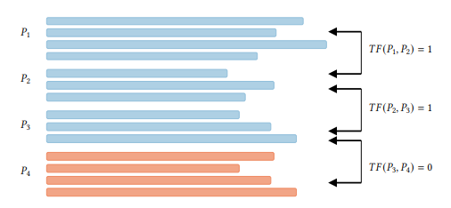
Sequential inference
Previous classifiers, sequential classification
Section breaks marked
𝑇𝐹(𝑝₁, 𝑝₂) = 𝑃(𝑇𝑜𝑝𝑖𝑐(𝑝₁) = 𝑇𝑜𝑝𝑖𝑐(𝑝₂))
Predicted labels 𝑦 = (𝑦₁, ..., 𝑦_{𝑘−1} )
A segmentation of the document is given by 𝑘 − 1 predictions of 𝑇𝐹, where 𝑦_{𝑖} = 0 denotes the end of a segment by 𝑝_{I}

Slide 16
Legal application
Section-based semantic segmentation as a pre-processing step for passage retrieval – additional data required
Similarity search – f. e. related sections in contracts
Document outlines - Wikipedia

Slide 17
Terms-of-Service dataset
Legal information for site users
Automatically extract the paragraphs
Shared set of topics

Slide 18
Crawling
Alexa 1M URL dataset, www
Landing page with Beautiful Soup Python package
Hyperlinks, Levenshtein distance of 0,75
Raw HTML is downloaded
74000 websites
JavaScript not supported

Slide 19
Section extraction
Non-trivial task
Boilerplate removal – boilerpipe package
HTML cleanup - <p>
Language detection – langid package
Extracting hierarchy – split by <h1><h6>, <b>, <li>, <u>, <p>, at least 5 occurencies, headings saved, enumeration patterns

Slide 20
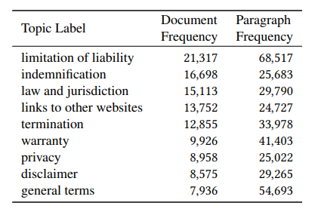
Data set statistics
Cleaned subset with manually grouped sections
554 section titles, 82 topics
Only top-level sections
80/10/10 train/validation/test
Avg number of sections is 6,56 and 22,32 paragraphs
2,92 paragraphs per section

Slide 21
Evaluation
Baselines:
Global Vectors (GLVavg)
tf-idf vectors (tf-idf)
Bag of Words (BoW)
Transformer models:
CLS sequence classification with roberta-base (Ro-CLS)
Sentence-transformers:
roberta-base (ST-Ro), ST-Ro-NLI
Training with HuggingFace, Siamese
1024 tokens

Slide 22
Prediction tasks
Train with an independent classification setup
Same section prediction task
Not directly comparable
3 sampling strategies
3 positive and 3 negative samples for each section
Same Section prediction, Random paragraph, Consecutive Paragraph sampling

Slide 23
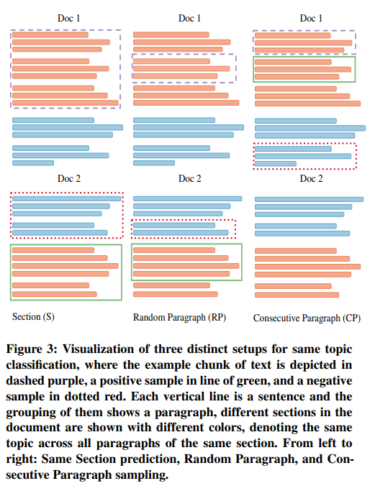

Slide 24
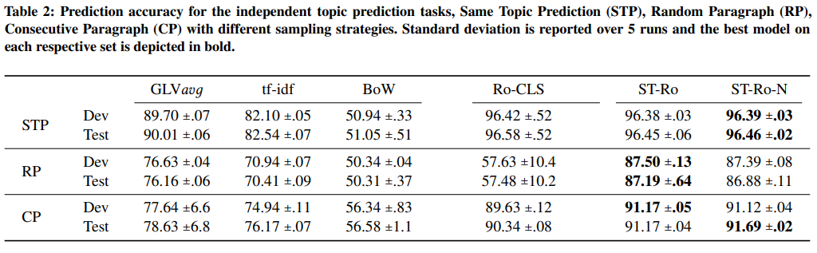

Slide 25
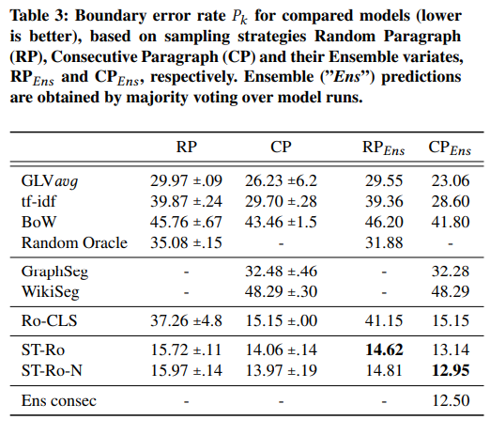
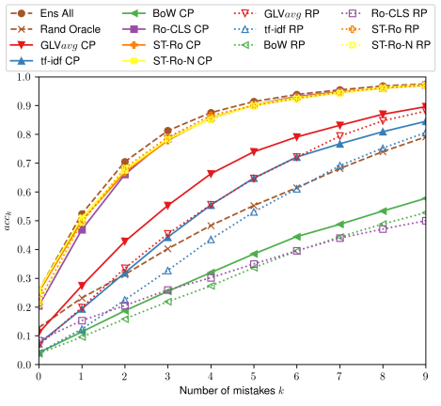
Text segmentation

Slide 26
Conclusion and future work
Multitude of previous works
Relaxation of the problem
Sequential setup to supervised Same Topic Prediction task
ToS dataset
Transformer-based models outperform text segmentation baselines
Deeper hierarchical sections
Interface

