Slide 1
Identifikácia postupu útočníka v sieti
Študent: Adam Kundracik
Vedúci práce: RNDr. Tomáš Bajtoš
Konzultant: Mgr. Ladislav Bačo

Slide 2
Lateral movement
Network Lateral Movement, or simply Lateral Movement, refers to the techniques that cyber attackers, or threat actors, use to progressively move through a network as they search for the key data and assets that are ultimately the target of their attack campaigns

Slide 3
Motivácia
Cyberattacks against corporate networks increased by 50% in 2021 compared to 2020.
Education and Research was the most targeted sector, with organizations facing an average of 1,605 weekly attacks.
Over 18 million websites are infected with malware at a given time each week.
92% of malware is delivered by email.

Slide 4
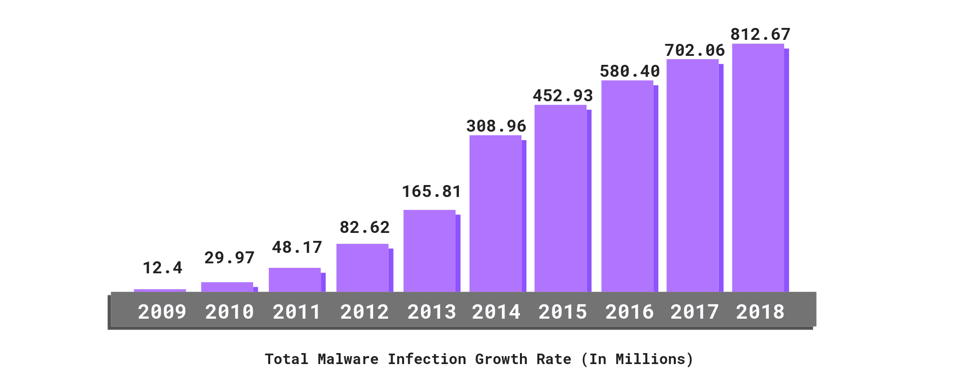

Slide 5
Ciele
Analýza a spracovanie vybraných techník postupu útočníka v sieti
Využívanie reálnych toolov, ktoré využívajú páchatelia pri svojej činnosti a následná simulácia útoku na vopred vytvorený uzavretý systém zariadení.

Slide 6
CIELE
2. Spracovanie a porovnanie prístupov k identifikácii postupu útočníka v sieti na základe záznamov z koncových zariadení
Analýza jednotlivých prístupov

Slide 7
CIELE
3. Návrh metódy identifikácie postupu útočníka v sieti, otestovanie metódy a zhodnotenie výsledkov
Prísť na to, ako najefektívnejšie detekovať hrozbu lateral movementu

Slide 8
literatúra
FAWAZ, Ahmed, et al. Lateral movement detection using distributeddata fusion. In: 2016 IEEE 35th Symposium on Reliable Distributed Systems(SRDS). IEEE, 2016. p. 21-30
TIAN, Zhihong, et al. Real-time lateral movement detection basedon evidence reasoning network for edge computing environment. IEEETransactions on Industrial Informatics, 2019, 15.7: 4285-4294.
HENDLER, Danny; KELS, Shay; RUBIN, Amir. Detecting maliciouspowershell commands using deep neural networks. In: Proceedings of the2018 on Asia conference on computer and communications security. 2018. p.187-197.
BAI, Tim, et al. A machine learning approach for rdp-based lateralmovement detection. In: 2019 IEEE 44th Conference on Local ComputerNetworks (LCN). IEEE, 2019. p. 242-245

Slide 9
zdroje
https://en.wikipedia.org/wiki/Network_Lateral_Movement
https://purplesec.us/resources/cyber-security-statistics/

